Slide 1
Opinion Mining for Text Data(Twitter)
Comparison of Various Feature Extraction Techniques.
CSC 869
Prof. Hui Yang.
Aaditya Chokshi - 918815487

Slide 2
Problem
Developing a ML model from the given dataset to accurately classify whether a given sentence(tweet) is positive or negative.
Calculating the impact of various techniques of feature extraction.

Slide 3
Dataset
Available on kaggle.
Dataset has 1.6 million tweets, half of which are positive and half are negative.
For, the purpose of this project, the dataset is sampled to 40000 tweets (20000 positive, 20000 negative).
The data contains user, date of the tweet, tweet id, tweet and the sentiment.
Tweets and the pre labelled sentiment is used.

Slide 4
Dataset Problems
The tweets do not have emoticons.
The size of the tweets is maximum 140 characters, so the model is not that extensive.
The sentiment is only negative or positive and no neutral tweets.

Slide 5
Approaches:
CountVectorizer with basic Text preprocessing (Using Regex) and Removing stop words. N_grams from range(1,3).
TF-IDF with basic Text Preprocessing (Regex , TFIDF vectorizer) without Removing Stopwords. N_grams from range(1,3).
Word2Vec model (Dimensions = 300).

Slide 6
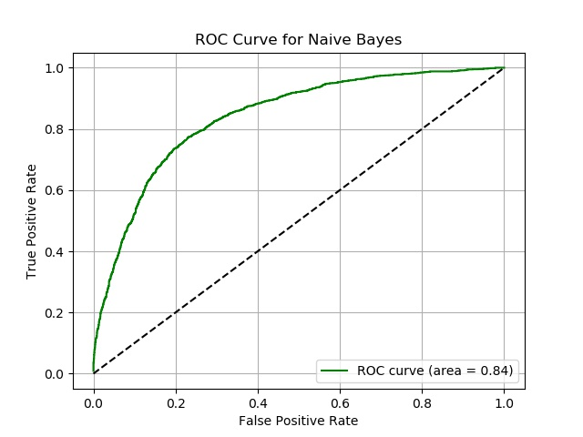
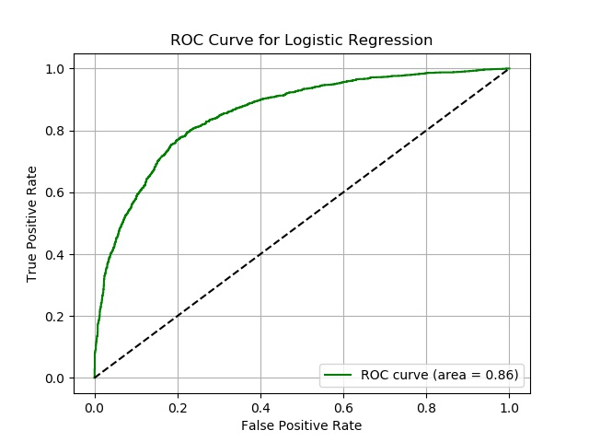
Count Vectorizer results
Accuracy Score = 77.30% Accuracy Score = 78.37%

Slide 7
Evaluations:
 | Accuracy score | f1score | false negative | false positive | precision | recall | true negative | true positive
Naive Bayes | 0.77355 | 0.770693153 | 428 | 477 | 0.780426867 | 0.761310145 | 1571 | 1522
Logistic Regression | 0.7856 | 0.787744214 | 449 | 408 | 0.780012189 | 0.79577165 | 1550 | 1591
K-NN | 0.609525 | 0.628227385 | 882 | 679 | 0.599450013 | 0.660427284 | 1117 | 1320
SVM | 0.772175 | 0.774882003 | 479 | 431 | 0.765837401 | 0.784228595 | 1520 | 1568

Slide 8
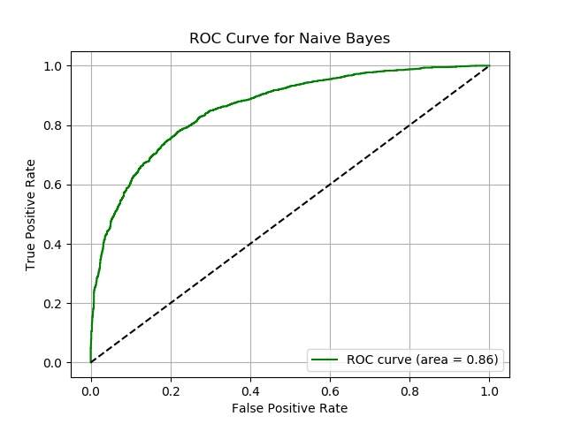

TF-IDF (ngrams 1-3)
Accuracy Score = 77.95% Accuracy Score = 77.01%

Slide 9
Evaluations:
 | Accuracy score | f1score | false negative | false positive | precision | recall | true negative | true positive
Naive Bayes | 0.7766 | 0.76757 | 369 | 524 | 0.799987124 | 0.737920459 | 1630 | 1475
Logistic Regression | 0.770975 | 0.774196 | 486 | 429 | 0.763525058 | 0.785280244 | 1513 | 1570
K-NN | 0.512975 | 0.519567 | 1003 | 944 | 0.512772409 | 0.527996368 | 996 | 1055
SVM | 0.7828 | 0.785483 | 459 | 409 | 0.775933383 | 0.795384834 | 1540 | 1590

Slide 10
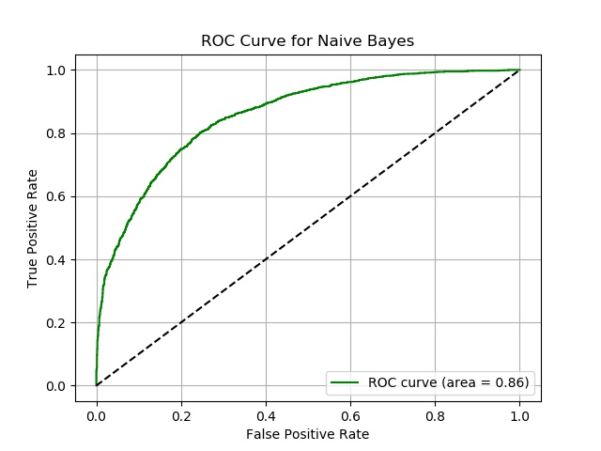
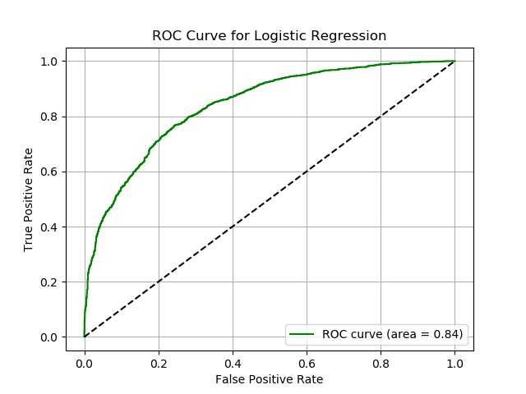
No Text Preprocessing TFIDF Vectorizer

Slide 11
Evaluations:
 | Accuracy score | f1score | false negative | false positive | precision | recall | true negative | true positive
Naive Bayes | 0.771175 | 0.75563 | 330 | 584 | 0.810951931 | 0.707794975 | 1669 | 1415
Logistic Regression | 0.7588 | 0.76171 | 506 | 457 | 0.75278726 | 0.771211394 | 1493 | 1542
K-NN | 0.682125 | 0.63023 | 358 | 912 | 0.752724667 | 0.543466738 | 1641 | 1087
SVM | 0.7778 | 0.78060 | 470 | 418 | 0.770860668 | 0.790824366 | 1529 | 1581

Slide 12
Word2Vec
Word vector dimensions = 300.
Accuracy score Logistic Regression : 53.92%
Accuracy score Random Forest : 53.27 %
Accuracy Score SVM : 53%
 | Accuracy score | f1score | false negative | false positive | precision | recall | true negative | true positive
Logistic Regression | 0.535625 | 0.550405422 | 1979 | 1736 | 0.534681401 | 0.567082294 | 2011 | 2274
Random Forest | 0.5335 | 0.5237366 | 1774 | 1958 | 0.536330371 | 0.511720698 | 2216 | 2052
SVM | 0.507 | 0.666441137 | 3874 | 70 | 0.504223189 | 0.982543641 | 116 | 3940

Slide 13
Limitations
Due to the large size of the dataset, memory errors occured, making it difficult to evaluate some classifiers.
Word2vec had a very less accuracy score for supervised learning.
No neutral labels; Not that helpful for real world data.

Slide 14
Future Work
Implement word2vec more extensively and implement it using an unsupervised learning method.
Consider neutral tweets to build a classifier.
Feature Ranking to consider the best features and develop a classifier with a better accuracy.
Use POS to reduce dimensions and help train a model with better accuracy.

Slide 15
Thank You.

